Slide 1

YAY! - Celebrating Education

Slide 2
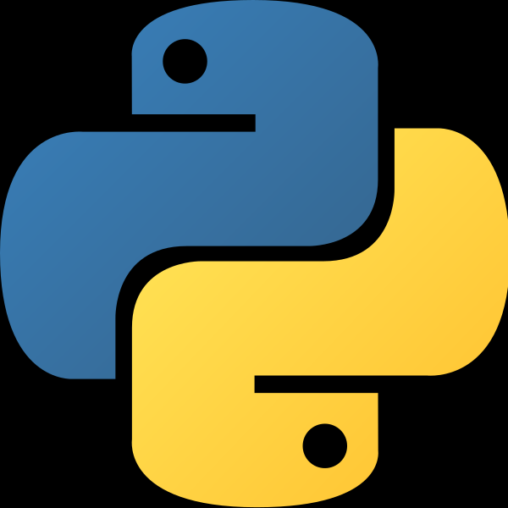
Welcome to the YAY's Python Course
(Basics)

Slide 3
Day 1

Slide 4
Course Agenda for Today?
Python Installation
Features of Python
Print Statement
Variables and Memory
Datatypes
Typecasting
Arithematic Operations in Python

Slide 5
Python Installation and Environments
Run .py (file extension of a Python File) via Command Prompt
Any Python IDE - eg - PyCharm.
Anaconda
Jupyter (Interactive Notebook Environment) [Extension of Anaconda]
Google Colab (Cloud Hosted Jupyter Environment)

Slide 6
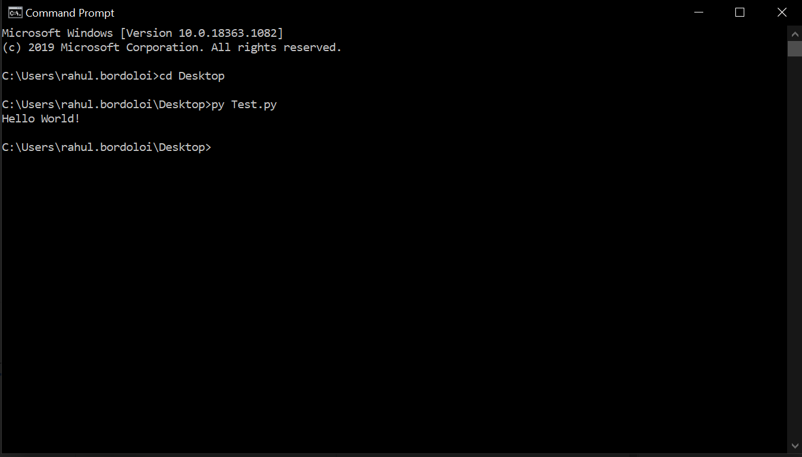
Command Prompt
Run .py file via command prompt.

Slide 7
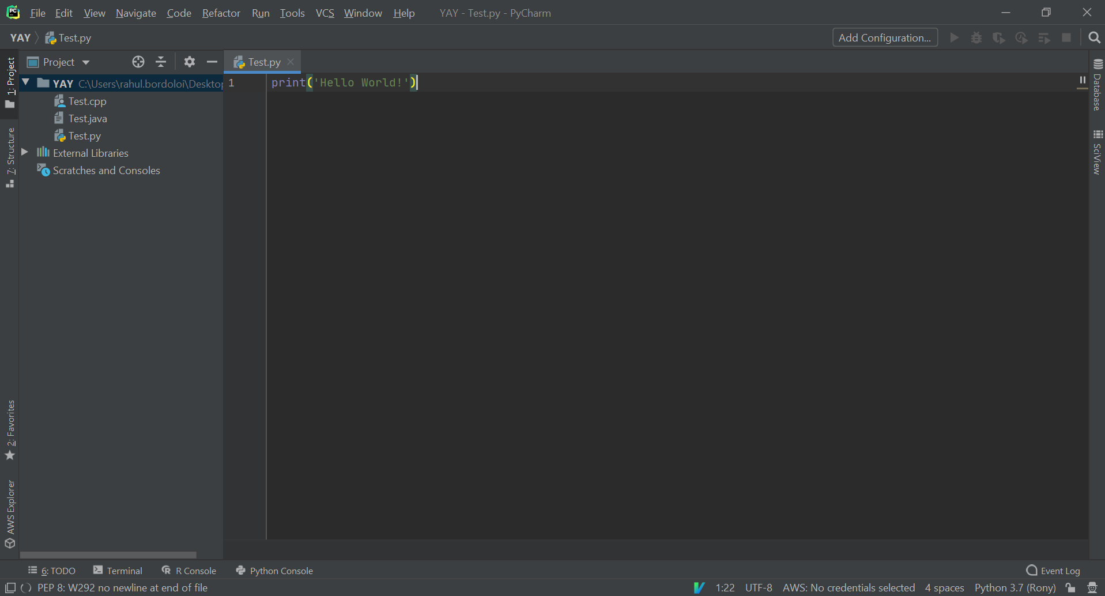
Python IDE - PyCharm
It's an Integrated Development Environment (IDE) for Python.
Code Analysis and Debugging and Unit Testing
Version Control System - CVS, Git

Slide 8
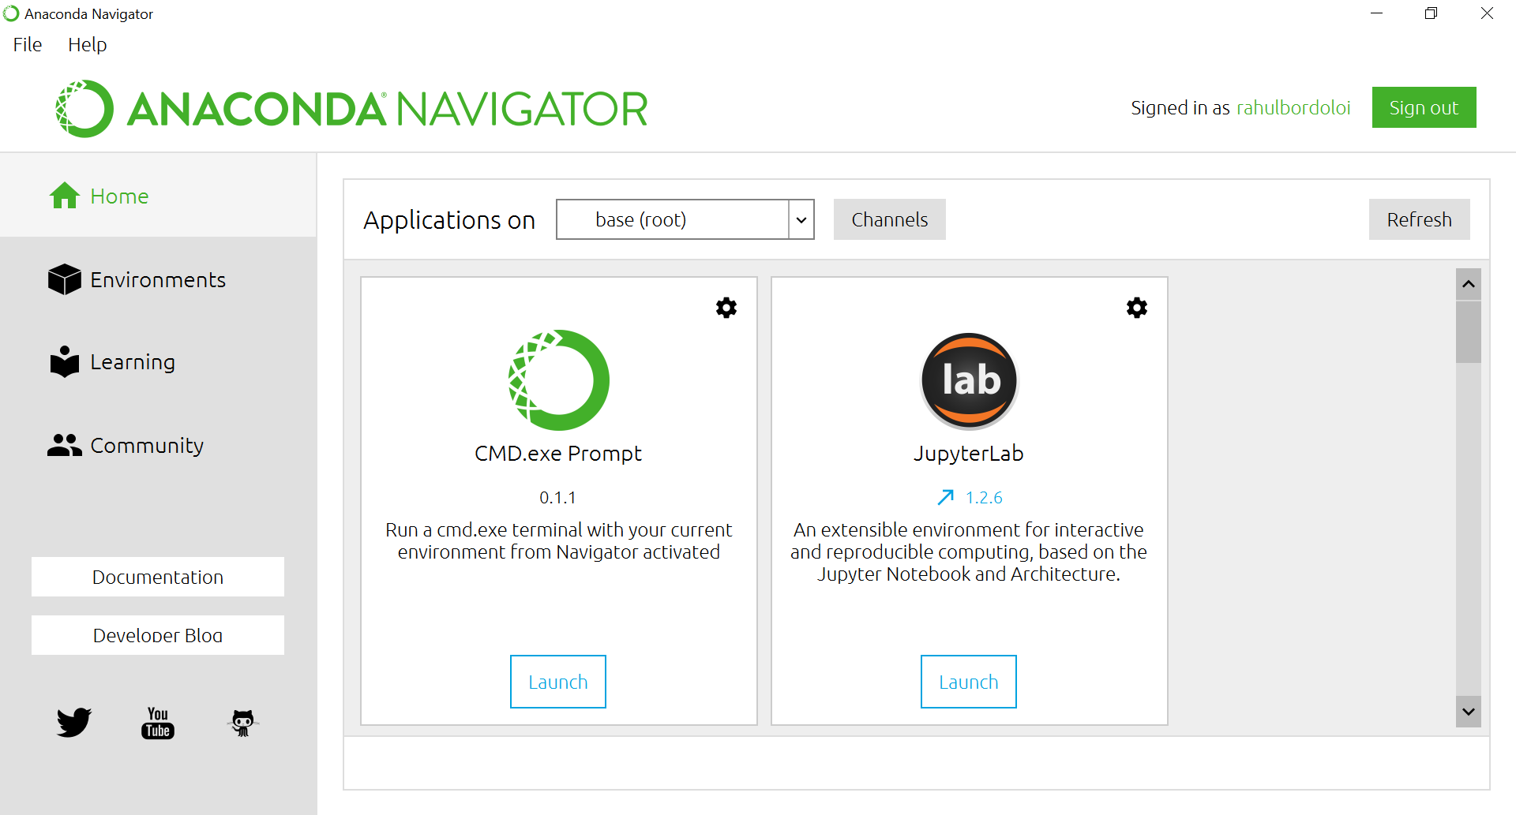
Anaconda
Open Source Distribution of Python and R Packages.
Being used by 13M users.
It includes over 1400 popular Packages
Widely used for Data Science related works.
Anaconda Python is faster than Vanilla Python.

Slide 9
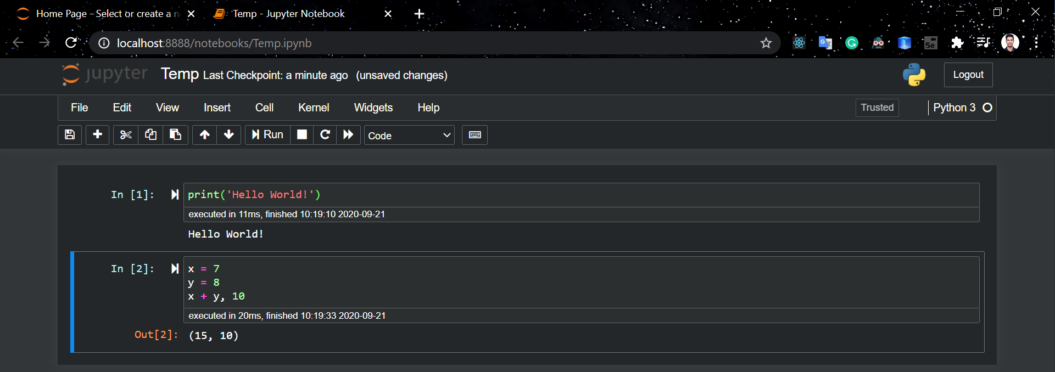
Jupyter
It's an interactive computing notebook environment. We can edit and run human readable docs while describing Data Analysis.

Slide 10
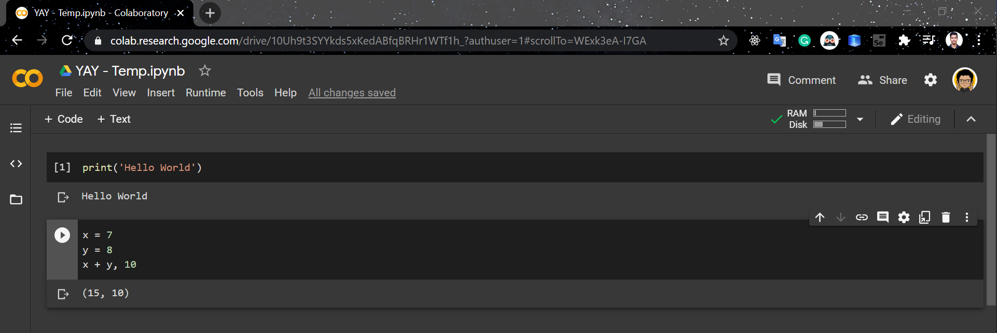
Google Colab
It's basically Jupyter, but cloud based. You can also share the same realtime!

Slide 11
Now, Installation!
I'll be sharing the Link now.

Slide 12

About Python
Python is an interpreted, high-level, general- purpose programming language.
Created by Guido van Rossum in 1989.
Python 1.0 released in 1994.
Python 2.0 released in 2000.
Python 3.0 released in 2008.
Note : We'll be using Python 3.6+ here in our Course.
Guido Van Rousom

Slide 13
What is Python?
Multi-Purpose (GUI, Scripting etc)
Interpreted Language
Multi-Platform Programming Language.
Multi Paradigm Programming Language
Strongly Typed and Dynamically Typed
Extendable and Portable
Free and Open Sourced.

Slide 14
Why Python?
High Level Programming Language.
You don't need to know about its architecture to code.
Simple to Learn.
English like Language.
You can literally use it anywhere ranging from Data Science to Development to Scraping to Testing etc.
Packages and Methods Everywhere and for Everything!
Community Support
And all the points from Previous Slide.

Slide 15
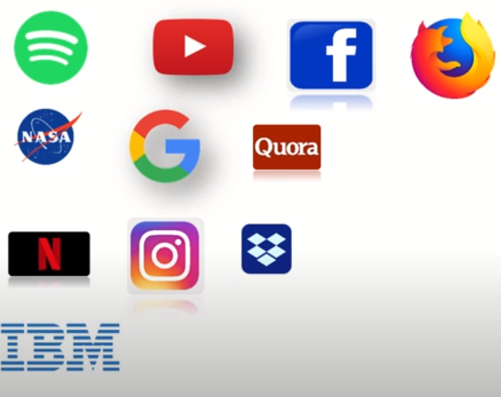
Where Python is being used?

Slide 16
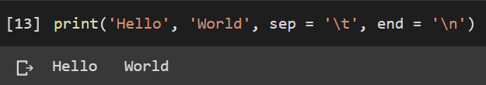
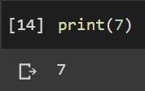
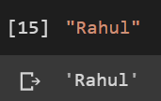
print() Statement
def : The print() function prints the specified message to the screen, or other standard output device.
Basic Syntax :
print(object(s), sep = separator, end = end)
Example

Slide 17
Variables and Memory
def : Variables are containers for storing data values such as texts and numbers etc.
Unlike other programming languages, Python has no command for declaring a variable.
A variable is created the moment you first assign a value to it.
Variables do not need to be declared with any particular type, and can even change type after they have been set. That's why Python is called as Dynamically Typed Language.

Slide 18
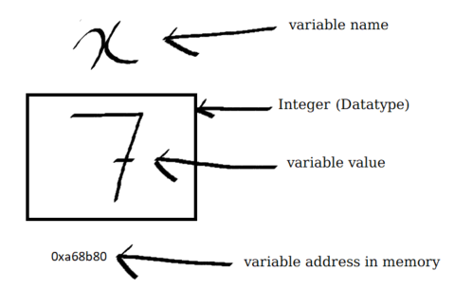
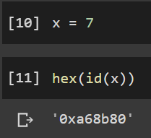
Memory Representation
High Level Representation of a variable assignment and it's memory address
Pictorial Representation of how variable is been stored in the memory.

Slide 19
Variables Naming Convention
(Identifiers)
A variable in Python can have a short name (like x and y) or a more descriptive name (age, myName, total_area).
Rules for Python variables:
A variable name must start with a letter or the underscore character
A variable name cannot start with a number.
A variable name can only contain alpha-numeric characters and underscores (A-z, 0-9, and _ ).
Variable names are case-sensitive (age, Age and AGE are three different variables).
You cannot use a reserved keyword as variable name.

Slide 20
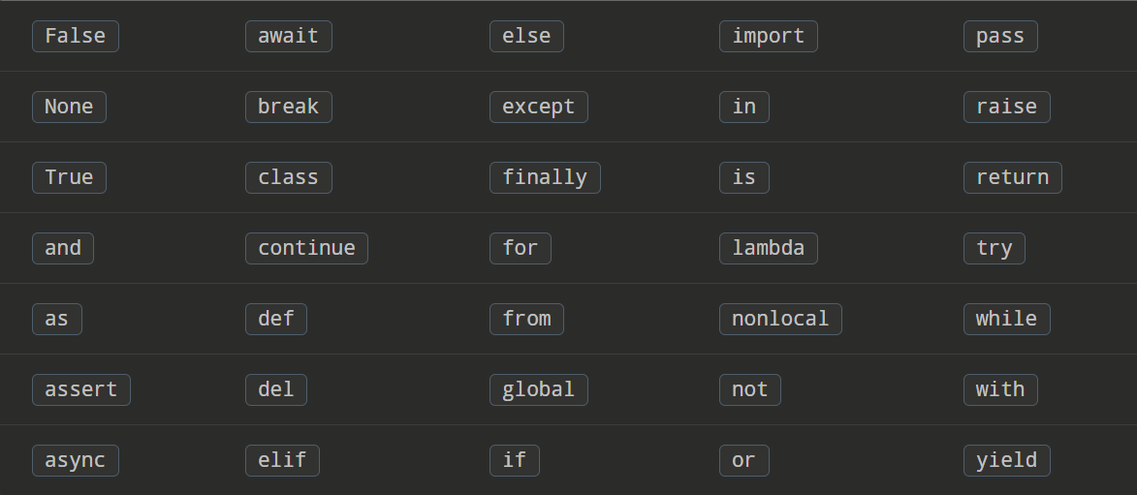
Python Keywords
Keywords are the reserved words in Python.
We cannot use a keyword as a variable name, function name or any other identifier. They are used to define the syntax and structure of the Python language.
In Python, keywords are case sensitive.
There are 33 keywords in Python 3.7.x, the numbers can vary over time.

Slide 21
Handson Exercise - I
WAP to Display your Full Name, your Age, and whether you’re a Student or not.
(Everything will be hardcoded as of now, user inputs will be taught in the next class)

Slide 22
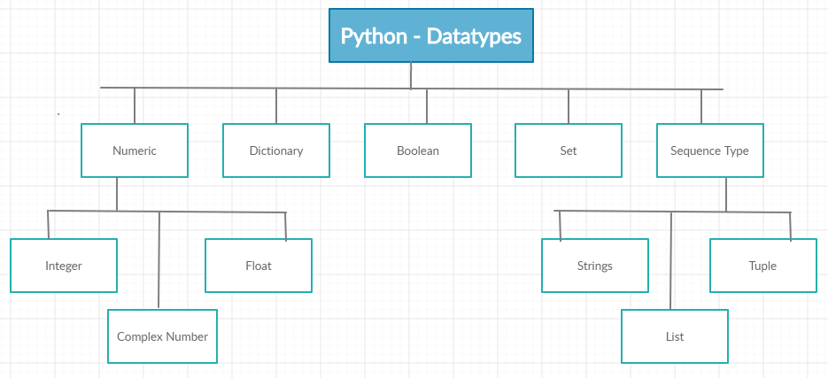
Datatypes in Python
The Basic Datatypes in Python are :
Numeric
Dictionary
Boolean
Set
Sequence Type

Slide 23
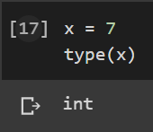
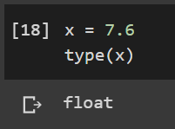
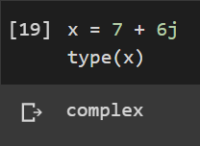
Numeric Datatype
The Different Numeric Datatypes in Python are :
Integer
eg - 7,8, 1000000008, etc..
Float
eg - 7.6, 8.7, 0.0000000001, etc..
Complex
eg - 4 + 6j, 8 +0.9j, etc..

Slide 24
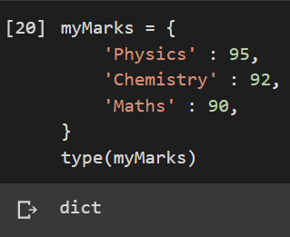
Dictionary Datatype
def: It's an unordered collection of data values. It's basically stores data in the form of `key:value` pair.
Each key-value pair in a Dictionary is separated by a
colon :, whereas each key is separated by a ‘comma’.
You can initialize a set object using `dict()`.

Slide 25
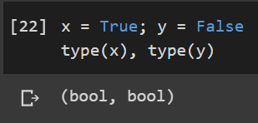
Boolean Datatype
Boolean Variable are of Two Types (Values) :
True
False
Any numerical value apart from 0 is regarded as `True`,
or else `False`.
You can initialize a set object using `bool()`.

Slide 26
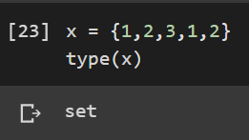
Set Datatype
def: Set is an unordered collection of data type that is iterable, mutable and has no duplicate elements.
You can initialize a set object using `set()`.

Slide 27
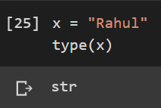
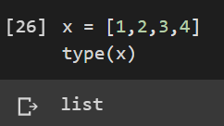
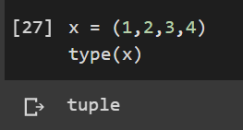
Sequence Type Datatype
It is known as Sequence type Datatypes as the storage locations are allocated in a continuous manner in the memory and can be accessed easily even if we know the address of a single entity.
There Types :
Strings
eg - “Rahul”, “Rony”, etc.
Lists
eg - [], [1,2,3], [1, “Rahul”], etc.
Tuples
eg - (), (1,2,3), (1, “Rahul”), etc.

Slide 28
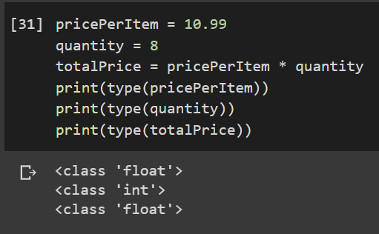
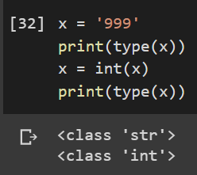
Typecasting
Typecasting are of Two Types :
Implicit Type Casting
Here, Python automatically converts one data type to another
data type. This process doesn't need any user involvement.
Basically, Python converts lower precision to higher precision
in order to preserve the data information.
Explicit Type Casting
Here, Users convert the data type of an object to required data type.
It depends on the user's requirement and usage.

Slide 29
Arithmetic Operations in Python
Arithmetic Operations in Python are analogous to general Mathematics. They are -
Addition (+)
Substraction (-)
Multiplication (*)
Division (/)
Modulus (%)
Exponential (**)
Floor Division (//)
Mathematical Operations in Python follow the same rule of BODMAS (Bracket-Of-Division-Multiplication-Addition-Substraction) as Mathematics.

Slide 30
Handson Exercise - II
WAP to convert a given weight (in kgs) into grams and print it on the terminal.
(Everything will be hardcoded as of now, user inputs will be taught in the next class)

Slide 31
Thank You
See you in the next class!

